Slide 1
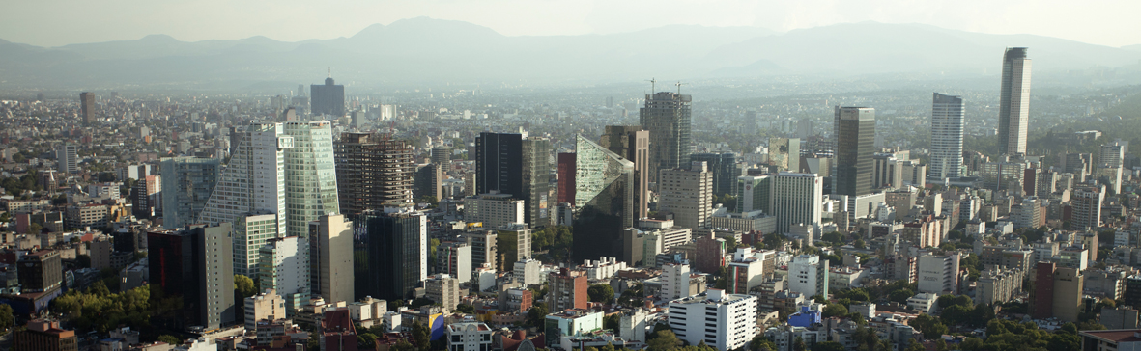
Vocational and Technical Education : Mexico’s Case
January 2013

Slide 2
Background
During the last decade, Latin-American countries have realized several efforts to strengthen and modernise Vocational and Technical Education, VET.
There is agreement among the members of the international community to keep pushing and strengthening VET due to its importance for the sustainable development of the countries and for the resolution of key socio-economical problems such as unemployment.

Slide 3
Mexico Overview
Mexico is set to be the world’s 7th largest economy by 2050.
The need for the Mexican work force to move up the value chain, deploying innovation in key sectors, to enhance the country’s competitiveness offers a wide range of partnership opportunities.
Education is a key area for this partnerships.

Slide 4
Mexico: Facts and Figures
Population and trends
Mexico is the second-largest economy in Latin America and the 13th in the world.
Mexico has approximately 112 million people, making it the country with the 11th-largest population in the world.
Over 50% of its population is under 25, with the largest age group between 15 and 19 years old (10% of the population).
Around 40% of the population is 19 years old or under, and the average of the population is currently 26.

Slide 5
Mexico: Facts and Figures
Geographical considerations
Mexico’s total area is nearly 2 million square kilometres (772 thousand miles), making it the 14th-largest country in the world.
Mexico is the fifth-largest country in the Americas, after Canada, the US, Brazil and Argentina.

Slide 6
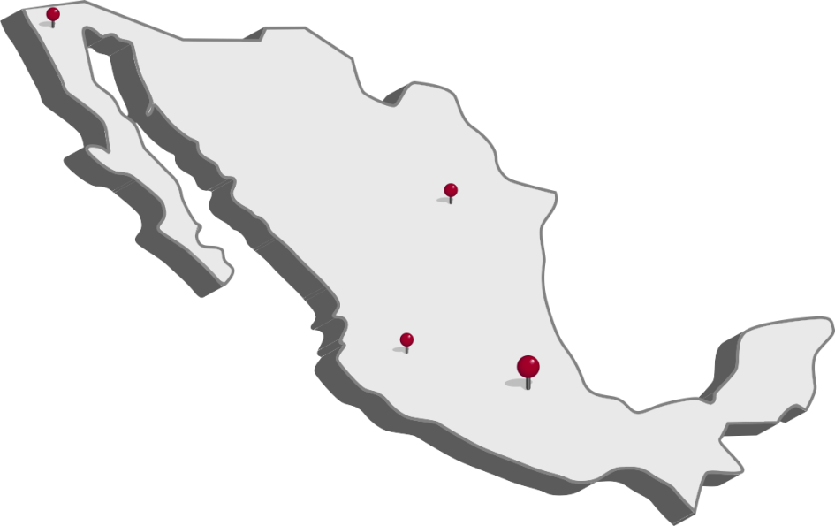
UKTI Mexico
UKTI Mexico, has a team of 32 people, based in the major cities: Mexico City, Guadalajara, Monterrey and Tijuana; dedicated to helping British companies export.
We can provide a variety of help – bespoke market reports, press and media services, suggestions of business partners, introductions and organisation of events.
During the past four years, more than 100 British companies have started and are now doing business in Mexico thanks to the support of UKTI team in Mexico.

Slide 7
Public Technical Education and Training
The Education Ministry (SEP) and the Labour Ministry (STPS) offer formal and informal technical education and training.
The Education Ministry is responsible for the National System of Technical Institutes (SNIT), which offers formal technical education and training from upper-secondary to graduate levels.

Slide 8
Public Technical Education and Training
VET provided under the Upper Secondary Education, includes three main types of programme:
“Training for work”
Those who complete lower secondary education may choose between two broad options of VET at ISCED 3 level.
“technical professional – baccalaureate”
“technological baccalaureate”

Slide 9
Public Technical Education and Training
In Mexico, there is a national COuncil for NOrmalisation and CERtification (CONOCER) having as main funding institutions: The Education Ministry, the Labour Ministry and the Economy Ministry .
The Ministry of Education created a framework of national qualifications and levels (following UNESCO’s CINE levels), meanwhile, CONOCER have sector-specific competency committees, who define occupational standards.

Slide 10
Training for labour based in the model of labour qualifications.
Spending in public education can not be less to 8% of the GDP and at least 1% of this amount will be devoted to R&D.
Through the CONOCER, representing the Training for labour, has created The Competences Management Committees for each sector (CMC), which permits the direct participation of the productive sectors to define a human capital agenda for the competitiveness of each sector and are in charge of defining and developing the Competence Standards.

Slide 11
Training for labour based in the model of labour qualifications.
In 2008 was launched the programme Training of Human Resources based in Qualifications, funded by the BID.
Today, 52 prestigious institutions –mainly national sector chambers, have been declared with "authorisation", meaning that they have permission, granted by the CONOCER to evaluate and certify competences in Mexico.

Slide 12
Mexican Vocational Education and Training system strengths
Mexico’s will to address the challenges faced by VET is illustrated by numerous recent initiatives, such as the reform of the technological baccalaureate and the creation of trainee grants.
VET in Mexico plays an important social role by providing learning opportunities to students at risk of dropping out.
Various initiatives, such as “mobile training units” reach out to students in remote regions with limited opportunities for learning.

Slide 13
Mexican VET system strengths
In some fields and subsystems of upper secondary VET, Mexico has excellent data on the labour market outcomes of VET graduates through the Labour Market Observatory
Encouraging measures have been taken to integrate VET into a broad framework of lifelong learning, including the elimination of dead-ends and recent reforms aiming to facilitate mobility within the educational system.

Slide 14
Mexican VET system strengths
There are some excellent examples of collaboration between VET schools and employers.
Many VET teachers and trainers have work experience in their field and often continue to work in industry part-time, which should help to keep their vocational skills up-to-date.

Slide 15
Challenges
Effective coordination and coherence within upper secondary VET remains a challenge.
The various subsystems of upper secondary VET sometimes have divergent interests, which hinders effective policy development.
Linkages between the VET system and employers still relatively weak.

Slide 16
Challenges
The existing set of VET qualifications is not regularly updated and has limited recognition in the labour market.
The pedagogical preparation of some VET teachers and trainers is insufficient.
There is wide variation both in the quantity and quality of workplace training for VET students.
There are weaknesses in the availability and use of data for policy making purposes and to inform stakeholders.

Slide 17
Paola JIMENEZ
UKTI Research Officer, Education & Training
Paola.Jimenez@fco.gov.uk

